Slide 1
Object-Oriented Analysis and Design
MVC: Model-View-controller architecture

Slide 2
What it is …
The Model-View-Controller (MVC) is an architecture, not a design pattern
Found to be very useful for web applications, windows applications, mobile apps, etc
The general structure of the architecture provides reuse of components, which is high priority
MVC can be used with just about any type of implementation language (Java, C++, C#, HTML/PHP, etc.

Slide 3
Why?
For most applications today, data is being manipulated and the application contains some kind of user interface which generates commands to create this manipulation
It has been recognized that the data is logically independent from how it is displayed to the user
Displays can be customized, but you don’t need to redesign the database tables each time
This implies a natural “layered” model architecture that separates the actual logic from the “view” (display)

Slide 4
MVC Architecture
Model
This usually represents the data or the actual programming logic – this is what the program actually does
Contains classes and methods that modify data or states
View
Renders data for the user to see
Accepts input from the user to initiate changes in the model
When the model changes, View must be updated
Controller
Translates user actions (button clicks, etc.) into operations on the Model

Slide 5
MVC Architecture

Slide 6
MVC in Java
View is made up of Swing widgets, like Jframes and Jbuttons
Controller is the ActionListeners
Model is composed of ordinary Java classes
Sometimes, ActionListeners may be included in the View, and the Controller may be made up of Java classes that implement business logic
In either case, the View and the Model are completely decoupled
MVC is also very popular in C#, and MS Visual Studio provides a template for MVC applications

Slide 7
MVC Implementation
General steps:
Instantiate the Model
Instantiate the View, may have reference to Controller (initially Null)
Instantiate the Controller, pass references to Model and View
Controller may then “register” with the View, so view has non-Null reference to Controller
How it works:
View recognizes an event, say a mouse click
View calls appropriate method on Controller, may pass information
Controller accesses relevant classes/methods in the Model, possibly creating changes or receiving information in return
If Model has changed (or information received), Controller updates View

Slide 8
MVC - Extended
Sometimes you see implementations where the Model directly communicates with the View, bypassing the Controller
Breaks “Model-View Separation”, but is occasionally useful
We will see more details on the pattern being displayed here later (called “Observer”)
View is notified directly of changes in Model, so View “observes” Model
Useful for asynchronous Model updates – Model changes independent of user interaction
Model may have multiple Views, but each View has only one Model
In this case the Model must update all Views that are observing it

Slide 9
MVC Architecture (Extended)

Slide 10
MVC Extended Implementation
General steps:
Instantiate the Model – has initial Null reference to View
Instantiate the View with reference to Model. View then “registers” with Model
Instantiate the Controller, pass references to Model and View. Controller then “registers” with View
How it works:
View recognizes an event, say a mouse click
View calls appropriate method on Controller, may pass information
Controller accesses relevant classes/methods in the Model, possibly creating changes or receiving information in return
If Model has changed, it notifies all relevant Views. View queries Model, gets any changes, displays

Slide 11
Observations
Controller and View can be tightly coupled
Controller occasionally produces own output, like a popup window
Occasionally there is information that is shared between Controller and View that does not involve the Model
User often control the Views themselves (scrollbars, etc.)
Bottom line: input and output are often combined in the GUI
Leads to new architecture: Delegate Model
Model – same as before
Delegate – responsible for input/output, combination of View and Controller
UI or Document View – actual GUI objects

Slide 12
Delegate Model Implementation
General steps:
Instantiate the Model – does not care about UI
Instantiate Delegate with reference to the Model
How it works:
Delegate recognizes event (from UI) and executes appropriate handler
Delegate accesses Model, possibly updates it
If Model has changed, UI is updated (through the Delegate)

Slide 13
MVC – How to Know You Did it Right
You can swap out a new UI easily
Same Model can be used without modification with a new UI
Your Model can be easily tested without the UI being completed, for example with JUnit
Model changes are quick – the GUI is frozen while the Model changes, and this should not take long

Slide 14
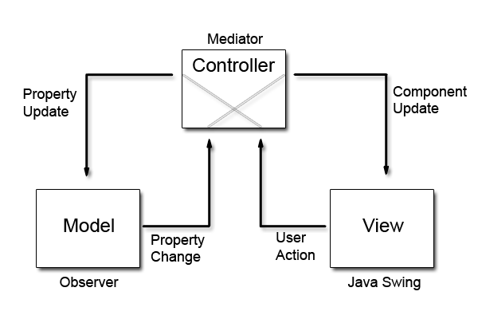
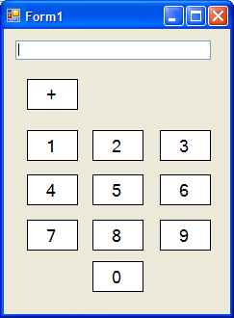
Example - Calculator
http://www.codeproject.com/Articles/25057/Simple-Example-of-MVC-Model-View-Controller-Design

Slide 15
Example - Calculator
Look at the Main() function – here is the section where the individual parts get created and linked
This is classic MVC – the Model does not talk to the View at all
Now look at CalcController
Note that the Model and View references are passed in typed to interfaces
This is much more robust, allows different Models or Views to be used
In the constructor, the Controller gets added to the View as a listener
OnClick – this method updates the View with information from the Model

Slide 16
Example - Calculator
Look at the code for frmCalcView
This will implement the ICalcView interface
Adds the reference to Controller as a listener
When a label button is clicked, the text is sent to the Controller
The lblPlus_Click() method also interacts with the Controller; this changes the state of the Model
Look at the Model code
Depending on the Model state, the Model either sets the current value to the input number or adds the input number to the current value

Slide 17
Example - Calculator
Walk through the operation:
A number key is pressed.
lbl_Click() method is invoked on the View (this is a listener for the UI number buttons)
The OnClick() method on the Controller is invoked, and the value of the button is passed
The Controller invokes the SetInput method on the Model, passing the number read from the button. The Model sets currentValue to the number and returns this value to the Controller, which displays it in the View’s Total text box.

Slide 18
Example - Calculator
The “+” button is pushed.
lblPlus_Click() method is invoked on the View (this is a listener for the UI “+” button)
The OnAdd() method on the Controller is invoked
The Controller invokes the ChangeToAddState() method on the Model. The Model changes its state to “Add”

Slide 19
Example - Calculator
Another number key is pressed.
lbl_Click() method is invoked on the View (this is a listener for the UI number buttons)
The OnClick() method on the Controller is invoked, and the value of the button is passed
The Controller invokes the SetInput method on the Model, passing the number read from the button.
Since the state of The Model is now “Add”, the Model adds the passed number to the currentValue and passes the sum to the Controller.
The Controller sets the value of the Total text field to the sum of the two numbers

